Slide 2
A Scalable Producer-Consumer Pool Based on Elimination –Diffraction Trees
Clayton Barham & Anthony Dinh

Slide 4
Intro

Slide 5
Intro

Slide 6
Intro

Slide 7
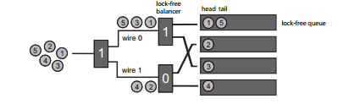
Intro

Slide 8
Intro

Slide 9
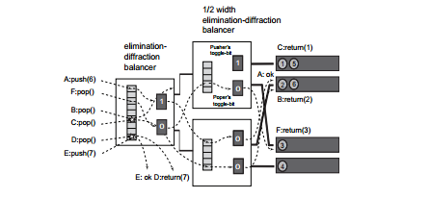
Intro

Slide 10
Implementation Issues
How to handle the collisions in the elimination array.
Memory management

Slide 11
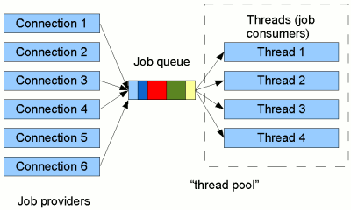
Implementation: Thread Pool

Slide 12
Testing: Test Platform
Toshiba Satellite S55-A5295 laptop
i7 Quad Core processor
8 logical cores
12 gigabytes of DDr3 RAM
Windows 10
Task manager only other application running

Slide 13
Testing: Methodology
24 Test Cases
Experimental and control groups
1, 2, 4, and 8 threads
Varied push and pop distributions: 25/75; 50/50, 75/25
40 Trials each
Measure time and throughput (48 data sets total)
Eliminate extreme values

Slide 14
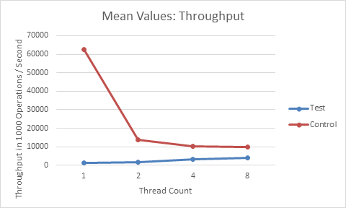
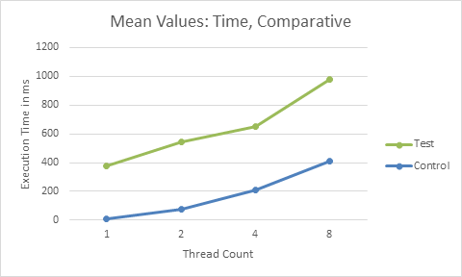
Testing: Experimental vs. Control

Slide 15
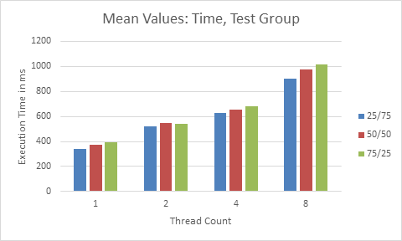
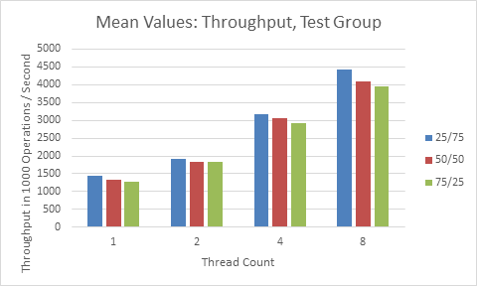
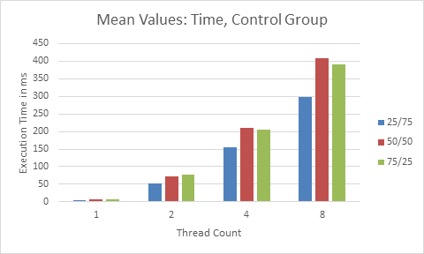
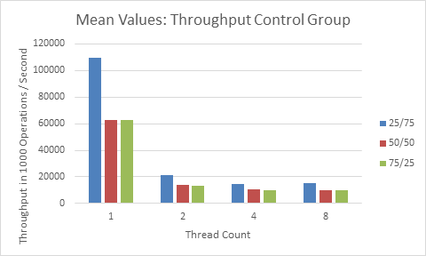
Testing: Data Breakdown

Slide 16
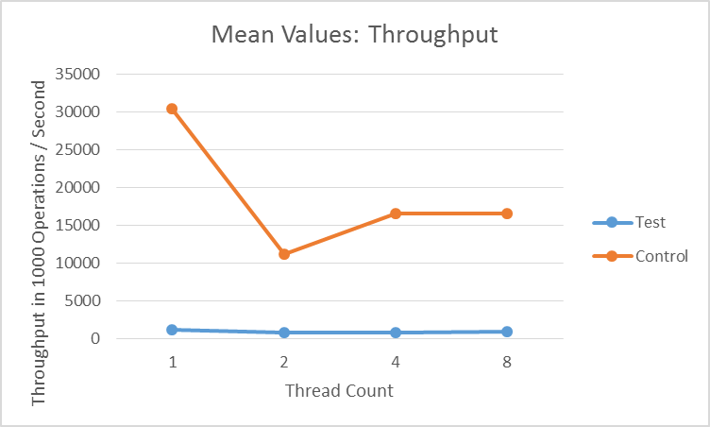
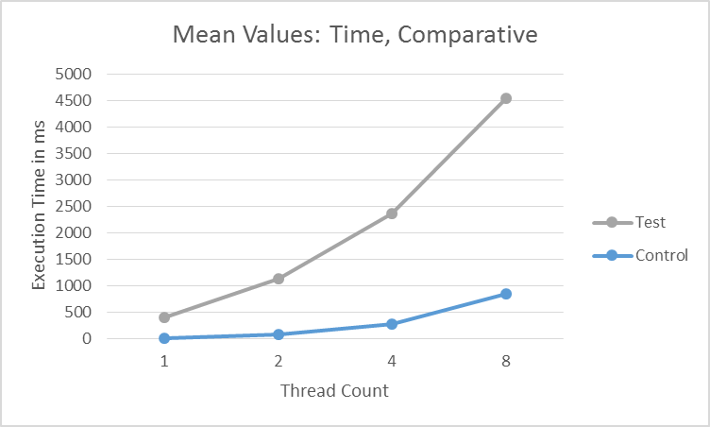
Testing: Concurrent vs. Sequential

Slide 17
Questions?

